Slide 1
Map-Reduce (Part I)
Professor Wei-Min Shen
University of Southern California
Thanks for source slides and material to: J. Leskovec, A. Rajaraman, J. Ullman: Mining of Massive Datasets (http://www.mmds.org)
Notes:
In last few years, map reduce has been widely used for mining really massive data sets.
Why we need Map reduce for processing the large data sets?
Start with basics

Slide 2
Single Node Architecture
GPU
CPU
Machine Learning, Statistics
Memory
Computational Model of CPU/GPU and memory
Notes:
Computational Model of CPU and memory
GPU is more efficient in manipulating computer graphics and image processing
The algorithm runs on CPU and accesses data that’s in memory.
Need to bring the data into memory from disk, but once the data is in memory, don’t need to access the disk again
This is the architecture that we use to implement all kinds of algorithm. things like machine learning and statistics.

Slide 3
Single Node Architecture
GPU
CPU
Machine Learning, Statistics
Memory
What if the data can’t fit in memory at the same time?
Notes:
What happened to the data is so big that it all cannot fit in memory at the same time?
That’s where data mining comes in

Slide 4
Single Node Architecture
GPU
CPU
Machine Learning, Statistics
Memory
“Classical” Data Mining algorithm
Disk
Notes:
classical data mining algorithm looks at the disk in addition to looking at memory.
So the data is on disk, you can only bring in a portion of the data into memory at a time.
And you can process it in batches and write back results to disk. This is the basic idea for the data mining algorithm.
But sometimes this is not sufficient.

Slide 5
Single Node Architecture
GPU
CPU
Machine Learning, Statistics
Memory
“Classical” Data Mining algorithm
Disk
Not sufficient !
Notes:
classical data mining algorithm looks at the disk in addition to looking at memory.
So the data is on disk, you can only bring in a portion of the data into memory at a time.
And you can process it in batches and write back results to disk. This is the basic idea for the data mining algorithm.
But sometimes this is not sufficient.

Slide 6
Motivation: Google Example
Crawling and indexing the web pages
10 billion web pages
Average size of webpage = 20 KB
➪ 10 billion * 20KB = 200 TB
The data is stored on a single disk and tends to be processed in CPU
Notes:
If using classical data mining model, all the data is stored on a single disk and the data tends to be processed in CPU.
The limitation here is bandwidth, the data bandwidth between disk and the CPU.
Clearly, this is not acceptable, you cannot wait 46 days for just reading the data

Slide 7
Motivation: Google Example
Crawling and indexing the web pages
10 billion web pages
Average size of webpage = 20 KB
➪ 10 billion * 20KB = 200 TB
The data is stored on a single disk and tends to be processed in CPU
One computer reads 50 MB/sec from disk (disk read bandwidth)
➪ Time to read = 4 million seconds ≈ 46 days
Even longer to do useful things with the data
Notes:
If using classical data mining model, all the data is stored on a single disk and the data tends to be processed in CPU.
The limitation here is bandwidth, the data bandwidth between disk and the CPU. Clearly, this is not acceptable, you cannot wait 46 days for just reading the data

Slide 8
Motivation: Google Example
Crawling and indexing the web pages
Split the data into chunks
Store and process the data in parallel in multiple disks and CPUs
e.g., 1,000 disks and CPUs
➪ Time to read = 4 million seconds / 1,000 = 4,000 seconds
Cluster Computing
GPU
CPU
Memory
Disk
Notes:
You can read and process the data in parallel in multiple CPUs
This is the fundamental idea behind the idea of cluster computing.

Slide 9
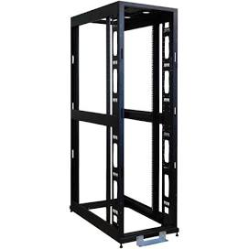
Cluster Architecture
Each rack contains 16-64 nodes
e.g., commodity Linux nodes
???
CPU
CPU
Memory
…
Memory
Disk
Disk
Node
Node
Notes:
the architecture for cluster computing is something like this.
You have the r acks consisting of for example commodity linux nodes, they are very cheap you can get thousands of them and rack them up.
These nodes are connected by a switch and a switch typically has 1 GB/sec bandwidth between any pair of nodes in a rack

Slide 10
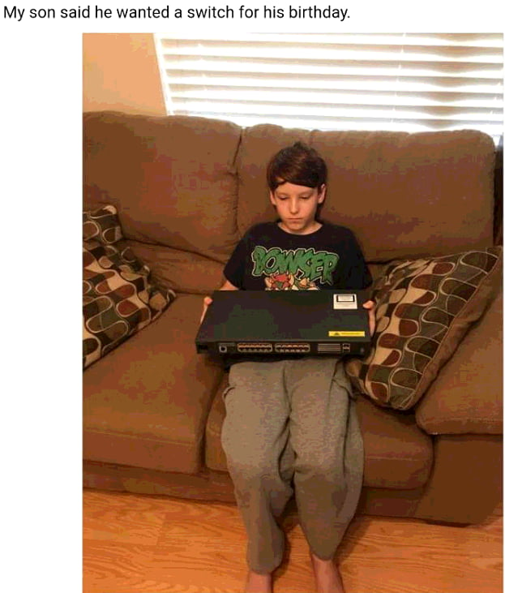
Cluster Architecture
Switch - connect nodes
e.g., 1 GB/sec bandwidth between any pair of nodes in a rack
Each rack contains 16-64 nodes
e.g., commodity Linux nodes
Switch
CPU
CPU
Memory
…
Memory
Disk
Disk
Node
Node
Notes:
the architecture for cluster computing is something like this.
You have the r acks consisting of for example commodity linux nodes, they are very cheap you can get thousands of them and rack them up.
These nodes are connected by a switch and a switch typically has 1 GB/sec bandwidth between any pair of nodes in a rack

Slide 11
Cluster Architecture
Backbone switch - connect racks
e.g., 2-10 GB/sec bandwidth between racks
Switch
Switch
Switch
CPU
CPU
CPU
CPU
Memory
…
Memory
…
Memory
…
Memory
Disk
Disk
Disk
Disk
node
node
node
node
rack
rack
Notes:
You would have multiple racks and the racks themselves are connected by backbone switches.
The backbone switch is a high bandwidth switch that can do 2-10 GB per second between racks

Slide 12
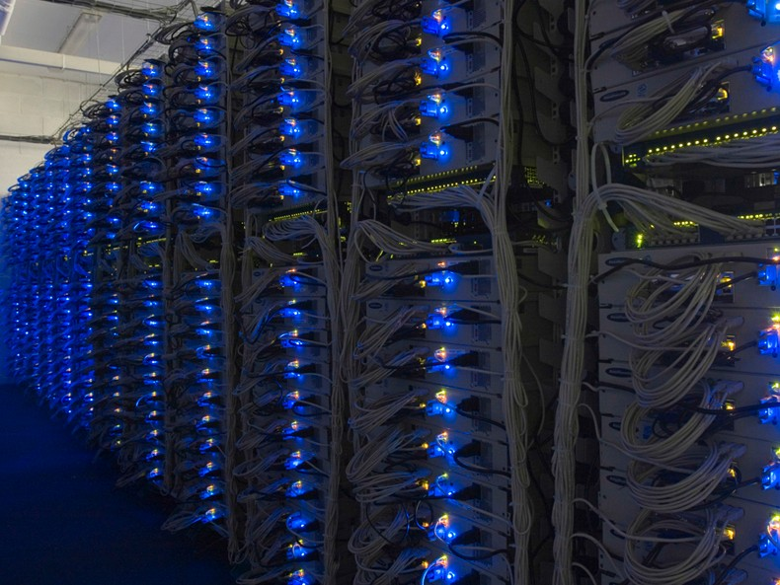
In 2011 it was guestimated that Google had 1M machines, http://bit.ly/Shh0RO
Notes:
In 2011, someone estimated that Google had a million machines like this. So that gives you a sense of the scale of the modern data centers.
This is the general architecture for storing and mining large data sets. Now once you have this kind of cluster, this does not solve the problem completely

Slide 13
Cluster Computing Challenges
Node failures
e.g., one server can stay up 3 years (1,000 days)
1,000 servers in cluster ⇒ 1 failure/day
1M servers in cluster ⇒ 1,000 failures/day
Notes:
The first and most challenge is that nodes can fail. A single node doesn’t fail that often. If you just let the node runs, it will probably stay up for 3 years.
You know, once in a 1000 days failure is not such a big deal.
You are going to get approximately one failure a day, which still is not such a big deal, you can probably deal with it.
You need some kind of infrastructure to deal with that kind of failure rate.

Slide 14
Cluster Computing Challenges I
Node failures
e.g., one server can stay up 3 years (1,000 days)
1,000 servers in cluster ⇒ 1 failure/day
1M servers in cluster ⇒ 1,000 failures/day
➪ Store data persistently and keep it available when nodes fail
➪ Deal with node failures during a long running computation
Notes:
This challenge introduce two problems here. persistently means that once you store the data, you are able to read it again.
But if the node in which you stored the data fails, then you cannot read the data, you might even loss the data. so how do you still get the data stored if these nodes fail.
Let’s say you are running the computation. and this computations is analyzing massive amount of data. You are at half of the process, and at this critical point, a couple of nodes fail, and those nodes had data that is necessary for the computation. In the worst case, go back and restart. Nodes might fail again.
Need an infrastructure to deal with the failures and let the computation go on even there are some failures.

Slide 15
Cluster Computing Challenges II
Network bottleneck
e.g., network bandwidth = 1 GB/sec
moving 10TB data takes approximately 1 day
➪ A framework that does not move data around so much while it’s doing computation
Notes:
The network itself can become a bottleneck.
Complex computation might need to move a lot of data.
1‘20

Slide 16
Cluster Computing Challenges III
Distributed/parallel programming is hard
➪ A simple model that hides most of the complexity

Slide 17
Map-Reduce
Map-Reduce addresses the challenges
Node failure
Store data redundantly on multiple nodes
Network bottleneck
Move computation close to data to minimize data movement
Distributed programming
Map function and Reduce functions
Notes:
3 mins

Slide 18


Redundant Storage Infrastructure
Distributed File System
Store data multiple times across a cluster
Provide global file namespace
E.g., Google GFS; Hadoop HDFS
Typical usage pattern
Huge files (100s of GB to TB)
Data is rarely updated in place
Reads and appends are common
Notes:
The first piece is redundant storage infrastructure.
Redundant storage is provided by what’s called distributed file system.
The distributed file system is a file system that stores the data across a cluster, but stores each piece of the data for multiple times.
For example, when Google encounters a new webpage, it add the page to a depository, doesn’t go and update the content of the webpage that it has already crawled.
The typical usage pattern is writing the data once and reading the data multiple times

Slide 19
Distributed File System
Data is kept in “chunks” spread across machines (chunk servers)
Each chunk is replicated on different machines
E.g., 4 chunk servers
Chunk server 1
Chunk server 2
Chunk server 3
Chunk server 4
Notes:
Let’s go deep into distributed file system to see how actually it works.
If you have a large file, it is divided into different chunks. So the machine themselves are called chunk servers in this context.
Chunk1, 2, 3, 4

Slide 20
Distributed File System
Data is kept in “chunks” spread across machines (chunk servers)
Each chunk replicated on different machines
E.g., 4 chunk servers , file 1 is split into 6 chunks
C₀
C₁
C₄
C₅
C₂
C₃
Chunk server 1
Chunk server 2
Chunk server 3
Chunk server 4
Notes:
file 1 c0 c1..c6
And these chunks as you can see four of the chunks happen to be on chunk sever 1. one of them is on chunk server 2 and one of them is on chunk server 3

Slide 21
Distributed File System
Data is kept in “chunks” spread across machines (chunk servers)
Each chunk replicated on different machines
E.g., 4 chunk servers , file 1 is split into 6 chunks
Not sufficient ! Need multiple copies of each chunk.
C₀
C₁
C₄
C₅
C₂
C₃
Chunk server 1
Chunk server 2
Chunk server 3
Chunk server 4
Notes:
This is not sufficient. You actually have to store multiple copies of each of these chunks and so…

Slide 22
Distributed File System
Data is kept in “chunks” spread across machines (chunk servers)
Each chunk replicated on different machines
E.g., 4 chunk servers , file 1 is split into 6 chunks
Each chunk is replicated twice, and the replicas of a chunk are never on the same chunk server.
C₀
C₁
C₁
C₂
C₄
C₀
C₄
C₅
C₂
C₅
C₃
C₃
Chunk server 1
Chunk server 2
Chunk server 3
Chunk server 4
Notes:
Here is a copy of c1 on chunk sever 2, a copy of c2 on chunk server2 and so on
If you notice that the copes of a chunk are always on different chunk servers

Slide 23
Distributed File System
Data is kept in “chunks” spread across machines (chunk servers)
Each chunk replicated on different machines
E.g., 4 chunk servers , file 1 is split into 6 chunks
Another file 2 has 2 chunks, D₀ and D₁
C₀
C₁
D₀
C₁
C₂
C₄
C₀
C₄
C₅
C₂
C₅
C₃
D₀
D₁
D₁
C₃
Chunk server 1
Chunk server 2
Chunk server 3
Chunk server 4
Notes:
Another file D has 2 chunks, D₀ and D_{1.}That’s stored on different chunk servers as well

Slide 24
Distributed File System
Data is kept in “chunks” spread across machines (chunk servers)
Each chunk replicated on different machines
C₀
C₁
D₀
C₁
C₂
C₄
C₀
C₄
C₅
C₂
C₅
C₃
D₀
D₁
D₁
C₃
Chunk server 1
Chunk server 2
Chunk server 3
Chunk server 4
Chunk servers also serve as compute servers
Bring computation to data!
Notes:
it turns out chunk servers also act as compute servers. And whenever your algorithm wants to access data, that computation is actually schedule on the chunk sever that contains data.
In this way, you avoid moving data to where the computation needs to run. but instead you move the computation to where the data is.

Slide 25
Components of Distributed File System
Chunk servers
File is split into contiguous chunks (typically 16-64 MB)
Each chunk is replicated (usually 2x or 3x)
Try to keep replicas in different racks (Why?)
Notes:
We saw that each chunk is stored in different chunk servers. but when you replicate 3 times, the system usually makes an effort to keep at least one replica in a entirely different rack if possible.
Why do we do that?

Slide 26
Components of Distributed File System
Chunk servers
File is split into contiguous chunks (typically 16-64 MB)
Each chunk is replicated (usually 2x or 3x)
Try to keep replicas in different racks
In case that the switch on a rack can fail and entire rack becomes inaccessible
Notes:
The most common scenario is that a single node can fail, but it is also possible that a switch on a rack can fail, and if a switch of a rack fails, the entire rack would become inaccessible.
And then if you keep all the chunks and all the replicas in one rack, all the data would be inaccessible.
So if you keep replicas of a chunk on different racks then even if a switch of a rack fails, you can still be able to access the data in other racks.
So in this way, the system makes sure you can still access the data even the whole rack fails.

Slide 27
Components of Distributed File System
Master node
a.k.a. Name Node in Hadoop HDFS
Stores metadata about where files are stored
e.g., it will know that file-1 is divided into 6 chunks, the locations of each of the 6 chunks and the locations of the replicas
Might be replicated
Otherwise it might become a single point of failure

Slide 28
Components of Distributed File System
Client library for file access
Talks to master to find chunk servers that store the chunks
Connects directly to chunk servers to access data without going through the master node
Notes:
When a client or an algorithm that needs to access the data, it goes through the client library

Slide 29
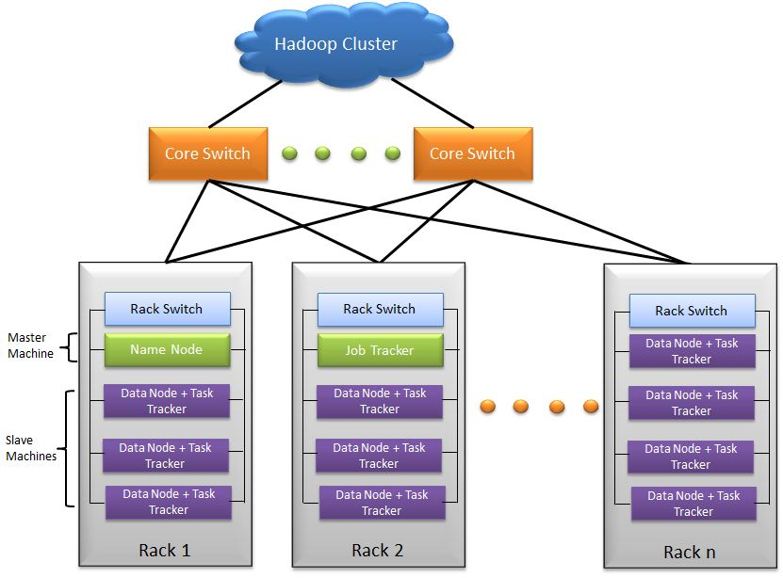
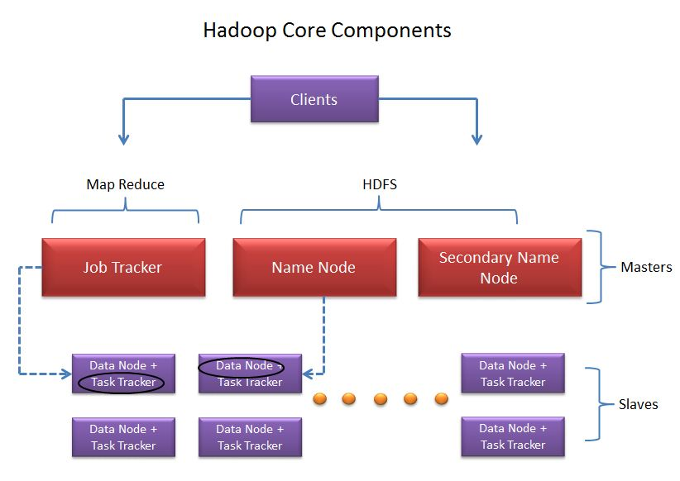
Hadoop Cluster
http://saphanatutorial.com/hadoop-cluster-architecture-and-core-components/

Slide 30
Programming Model: Map-Reduce
Warm-up task
We have a huge text document
Count the number of times each distinct word appears in the file
Sample application:
Analyze web server logs to find popular URLs
A thought experiment: ☺ ☺ ☺
You and your friends are given today’s New York Times newspaper
How would you do the above tasks?
Notes:
For example, we might find the word “the” appears 10 millions times and the word ”apple” appears 400 times.\
Some sample applications of this kind of toy example in real world.
For example, if you have a big depth of log, and you want to find out how often each URL is accessed.
1:15

Slide 31
Task: Word Count
Case 1
The File itself is too large for memory; but all <word, count> pairs can fit in memory
How to solve ?

Slide 32
Task: Word Count
Case 1
File is too large for memory, but all <word, count> pairs fit in memory
Solution:
Use a hash table (word -> count) to store the number of times that word appears
Make a simple sweep through the file, and will have the word count pairs for every unique word.
Notes:
Wen you first see a word, you add the entry to the hash table and set the count to 1.
And every subsequent time you see the word, you increment the count by one.

Slide 33
Task: Word Count
Case 2
Even the <word, count> pairs do not fit in memory
Solution:
Map-Reduce

Slide 34
Map-Reduce: Overview
Map
Divide the file into many “records”
Extract something (e.g., word) from each record (as key)
Output one or multiple things for each record
Group by key
Sort and shuffle
Reduce
Aggregate, summarize, filter or transform
Output the result
Notes:
It groups all the same keys together.

Slide 35
Map-Reduce: Overview
Map
Extract something (e.g., word) from each record (as keys)
Output one or multiple things for each record
Group by key
Sort and shuffle
Reduce
Aggregate, summarize, filter or transform
Output the result
Outline stays the same, Map and
Reduce change to fit the problem
Notes:
In this case, the word count, the map reduce function is quite simple, but in other scenario, the map reduce function could be more complicated

Slide 36
Map-Reduce: The Map Step
Input: key-value pairs
k
v
k
v
…
k
v
Notes:
Here is another way of looking at it.
Start with a bunch of key value pairs.

Slide 37
Map-Reduce: The Map Step
Intermediate key-value pairs
Input: key-value pairs
k
v
map
k
v
k
v
k
v
…
k
v
Notes:
The map step takes the key-value pairs and maps them to intermediate key-value pairs.
For example, you run the map for the first key value pair (k, v) and it actually outputs two intermediate key value pairs.
the key in the intermediate key value pairs do not need to have the same key as the input. They could be different keys and they could be multiple of them.
They values could be different as well.
Notice, there could be zero, one or multiple key-value pairs for each key value pairs.

Slide 38
Map-Reduce: The Map Step
Intermediate key-value pairs
Input: key-value pairs
k
v
k
v
k
v
map
k
v
k
v
…
k
v

Slide 39
Map-Reduce: The Map Step
Intermediate key-value pairs
Input: key-value pairs
k
v
k
v
k
v
k
v
k
v
…
…
k
v
k
v
Notes:
So we go through the input file, apply the map function on each input record, and create the intermediate key-value pairs.

Slide 40
Map-Reduce: The Reduce Step
Shuffle/Group by Key Step
Intermediate key-value pairs
Key-value groups
k
v
k
v
v
v
k
v
Group by key
k
v
v
k
v
…
…
k
v
k
v
Notes:
Now the next step, is to take the intermediate key-value pairs and group them by key.
All the intermediate key-value pairs that have the same key will be grouped together.
So it turns out, there are three values with the first key, two values with the second key.
And these are all different values, although I use the same color here.

Slide 41
Map-Reduce: The Reduce Step
Shuffle/Group by Key Step
Intermediate key-value pairs
Key-value groups
Output key-value pairs
reduce
k
v
k
v
v
v
k
v
k
v
Group by key
k
v
v
k
v
…
…
k
v
k
v
Notes:
The reducer takes look at a single key-value group as input and produces the output that has the same key.
But it combines the values for a given key into a single value. For example, it could add up all the values. Or it could multiple them, Or it could compute the average of them
Or even more complicated computations base on your requirement.

Slide 42
Map-Reduce: The Reduce Step
Shuffle/Group by Key Step
Intermediate key-value pairs
Key-value groups
Output key-value pairs
reduce
k
v
k
v
v
v
k
v
reduce
k
v
Group by key
k
v
v
k
v
k
v
…
…
…
k
v
k
v
k
v
Notes:
And them the reducer looks at the second key-value group and output a single value for that key
and repeat this operation for all the key-value groups.

Slide 43
More formally…
Input: a set of key-value pairs
Programmer need to specify two methods:
Map(k, v) → <k’, v’>*
Takes a key-value pair and outputs a set of key-value pairs
E.g., key is the filename, value is a single line in the file
There is one Map call for every (k, v) pair
Reduce(k’, <v’>*) → <k’, v’’>*
All values v’ with same key k’ are reduced together
There is one Reduce function call per unique key k’
Notes:
The reducer takes a set of key value groups, the group consists of a key and a set of values for that key.
In the output, once again, the key is the same as the input key but the value is obtained by combining the input values in some manner.

Slide 44
Map-Reduce: Word Count
The crew of the space shuttle Endeavor recently returned to Earth as ambassadors, harbingers of a new era of space exploration. Scientists at NASA are saying that the recent assembly of the Dextre bot is the first step in a long-term space-based man/mache partnership. '"The work we're doing now
-- the robotics we’re doing -- is what we're going to need ……………………..
Big document
Notes:
Let’s take a look at the word count example. and run that map-reduce process again.
You can see the words there

Slide 45
Map-Reduce: Word Count
Provided by the programmer
MAP:
Read input and produces a set of key-value pairs
The crew of the space shuttle Endeavor recently returned to Earth as ambassadors, harbingers of a new era of space exploration. Scientists at NASA are saying that the recent assembly of the Dextre bot is the first step in a long-term space-based man/mache partnership. '"The work we're doing now
-- the robotics we’re doing -- is what we're going to need ……………………..
(The, 1)
(crew, 1)
(of, 1)
(the, 1)
(space, 1)
(shuttle, 1)
(Endeavor, 1)
(recently, 1)
….
Big document
(key, value)
Notes:
And we are going to take the map function that’s provided by the programmer.
The mapper reads the input and produces a set of key-value pairs.
In this case, each word would become the key and value would be number 1

Slide 46
Map-Reduce: Word Count
Provided by the programmer
MAP:
Read input and produces a set of key-value pairs
Group by key:
Collect all pairs with same key
The crew of the space shuttle Endeavor recently returned to Earth as ambassadors, harbingers of a new era of space exploration. Scientists at NASA are saying that the recent assembly of the Dextre bot is the first step in a long-term space-based man/mache partnership. '"The work we're doing now
-- the robotics we’re doing -- is what we're going to need ……………………..
(The, 1)
(crew, 1)
(crew, 1)
(crew, 1)
(space, 1)
(of, 1)
(the, 1)
(the, 1)
(space, 1)
(shuttle, 1)
(the, 1)
(the, 1)
(Endeavor, 1)
(recently, 1)
….
(shuttle, 1)
(recently, 1)
…
Big document
(key, value)
(key, value)
Notes:
So the next step is grouping by key. So you can see there are two tuples with the key crew and then those a collected together here.
They are all sorted and collected together.

Slide 47
Map-Reduce: Word Count
Provided by the programmer
Provided by the programmer
MAP:
Read input and produces a set of key-value pairs
Group by key:
Collect all pairs with same key
Reduce:
Collect all values belonging to the key and output
The crew of the space shuttle Endeavor recently returned to Earth as ambassadors, harbingers of a new era of space exploration. Scientists at NASA are saying that the recent assembly of the Dextre bot is the first step in a long-term space-based man/mache partnership. '"The work we're doing now
-- the robotics we’re doing -- is what we're going to need ……………………..
(The, 1)
(crew, 1)
(crew, 1)
(crew, 1)
(space, 1)
(crew, 2)
(space, 2)
(the, 3)
(shuttle, 1)
(recently, 1)
…
(of, 1)
(the, 1)
(the, 1)
(space, 1)
(shuttle, 1)
(the, 1)
(the, 1)
(Endeavor, 1)
(recently, 1)
….
(shuttle, 1)
(recently, 1)
…
Big document
(key, value)
(key, value)
(key, value)
Notes:
This is the simple process of the map reduce process.
But in real life, we would have our data on multiple nodes.

Slide 48
Map-Reduce: Word Count
Provided by the programmer
Provided by the programmer
MAP:
Read input and produces a set of key-value pairs
Group by key:
Collect all pairs with same key
Reduce:
Collect all values belonging to the key and output
The crew of the space shuttle Endeavor recently returned to Earth as ambassadors, harbingers of a new era of space exploration. Scientists at NASA are saying that the recent assembly of the Dextre bot is the first step in a long-term space-based man/mache partnership. '"The work we're doing now
-- the robotics we’re doing -- is what we're going to need ……………………..
(The, 1)
(crew, 1)
(crew, 1)
(crew, 1)
(space, 1)
(crew, 2)
(space, 2)
(the, 3)
(shuttle, 1)
(recently, 1)
…
(of, 1)
(the, 1)
(the, 1)
(space, 1)
(shuttle, 1)
(the, 1)
(the, 1)
(Endeavor, 1)
(recently, 1)
….
(shuttle, 1)
(recently, 1)
…
Big document
(key, value)
(key, value)
(key, value)
Notes:
So here is the data, the data actually divided here into multiple nodes.
So let’s say the first portion of the file is chunk 1 and it’s on one node. The second portion of the file here is chunk 2, which is on a different node,

Slide 49




Map-Reduce: Word Count
Provided by the programmer
Provided by the programmer
MAP:
Read input and produces a set of key-value pairs
Group by key:
Collect all pairs with same key
Reduce:
Collect all values belonging to the key and output
The crew of the space shuttle Endeavor recently returned to Earth as ambassadors, harbingers of a new era of space exploration. Scientists at NASA are saying that the recent assembly of the Dextre bot is the first step in a long-term space-based man/mache partnership. '"The work we're doing now
-- the robotics we’re doing -- is what we're going to need ……………………..
(The, 1)
(crew, 1)
(crew, 1)
(crew, 1)
(space, 1)
(crew, 2)
(space, 2)
(the, 3)
(shuttle, 1)
(recently, 1)
…
(of, 1)
(the, 1)
(the, 1)
(space, 1)
(shuttle, 1)
(the, 1)
(the, 1)
(Endeavor, 1)
(recently, 1)
….
(shuttle, 1)
(recently, 1)
…
Big document
(key, value)
(key, value)
(key, value)
Notes:
Now the map tasks are going to be running on each of these four different nodes. That means there would be a map task that just looks at chunk 1 the first portion of the file.
a map task that just looks at chunk 2 the first portion of the file.
Here is output result for the first chunk of map output. Here is the output for the second chunk of map output which is on another node.
Now the output of the map function are spread across multiple nodes. What map does it that it copies the Map outputs onto a single node.
You can see the data from all these four nodes flowing into this single node here.
And once the data has flowed to a single node, you can do group by key and then do the final reduce step.

Slide 50
Map-Reduce: Word Count
Provided by the programmer
Provided by the programmer
MAP:
Read input and produces a set of key-value pairs
Group by key:
Collect all pairs with same key
Reduce:
Collect all values belonging to the key and output
The crew of the space shuttle Endeavor recently returned to Earth as ambassadors, harbingers of a new era of space exploration. Scientists at NASA are saying that the recent assembly of the Dextre bot is the first step in a long-term space-based man/mache partnership. '"The work we're doing now
-- the robotics we’re doing -- is what we're going to need ……………………..
(The, 1)
(crew, 1)
(crew, 1)
(crew, 1)
(space, 1)
(crew, 2)
(space, 2)
(the, 3)
(shuttle, 1)
(recently, 1)
…
(of, 1)
(the, 1)
(the, 1)
(space, 1)
(shuttle, 1)
(the, 1)
(the, 1)
(Endeavor, 1)
(recently, 1)
….
(shuttle, 1)
(recently, 1)
…
Big document
(key, value)
(key, value)
(key, value)
Notes:
Tricky thing, you might not want to move all the data from all the nodes into a single reduce node and do the computation on that node.
So in practice, you use multiple reduce nodes as well. And when you run a map-reduce job, you can tell the system to use a certain number of reduce nodes. Let’s say in this case, we tell the system that we use three reduce nodes. If you tell the system you would use three reduce node, then the system is smart enough to split the output of the map into three reduce nodes.
But one thing need to make sure, is that all instances of the same key, regardless of which Map node they come from. always end up at the same reduce node.
So for example, all the word “the” no matter from map node 1 or map node 2 will ended up at reduce node 2 in this case.
=> Hash function, hashes each key and determines which reduce node it should go. In this way, it ensures that all tuples with the same key would go to the same reduce node.
And the result now is generated on multiple reduce nodes. For example, the result for crew is now on reduce node 1.....
Which is actually fine because we have the master node that knows the result file is spread across three nodes in the system.
You would still get a single file on your client, and the system knows to access the data from those three independent nodes.

Slide 51
Map-Reduce: Word Count
pseudo-code
map(key, value):
// key: document name; value: text of the document for each word w in value:
emit(w, 1)
reduce(key, values):
// key: a word; value: an iterator over counts
result = 0
for each count v in values:
result += v
emit(key, result)

Slide 52
Map-Reduce example 2
Build an inverted index
(ID, content) => (content, List[IDs])
Application: Search Engines, supporting full text searches
Input:
tweet1, (“I love pancakes for breakfast”) tweet2, (“I dislike pancakes”)
tweet3, (“What should I eat for breakfast?”)
tweet4, (“I love to eat”)
Desired output:
“pancakes”, (tweet1, tweet2) “breakfast”, (tweet1, tweet3) “eat”, (tweet3, tweet4)
“love”, (tweet1, tweet4)
…
Map task:
What intermediate (key, value) pairs produced?
Reduce task:
?
Notes:
Parse the tweet to identify individual words
For each word, emit (word, tweetID) as intermediate key-value pair
Groups key-value pairs by key (word)
Reduce function then just emits key and list of tweetIDs associated with that key

Slide 53
Map-Reduce example 2
Build an inverted index
(Location, content) => (content, location)
Application: Search Engines, supporting full text searches
Input (key, value):
tweet1, (“I love pancakes for breakfast”) tweet2, (“I dislike pancakes”)
tweet3, (“What should I eat for breakfast?”)
tweet4, (“I love to eat”)
Desired output:
“pancakes”, (tweet1, tweet2) “breakfast”, (tweet1, tweet3) “eat”, (tweet3, tweet4)
“love”, (tweet1, tweet4)
…
Map task:
For each word in input value, emit (word, tweet_ID) as intermediate (key, value) pair
Reduce task
?
Notes:
Parse the tweet to identify individual words
For each word, emit (word, tweetID) as intermediate key-value pair
Groups key-value pairs by key (word)
Reduce function then just emits key and list of tweetIDs associated with that key

Slide 54
Map-Reduce example 2
Build an inverted index
(Location, content) => (content, location)
Application: Search Engines, supporting full text searches
Input (key, value):
tweet1, (“I love pancakes for breakfast”) tweet2, (“I dislike pancakes”)
tweet3, (“What should I eat for breakfast?”)
tweet4, (“I love to eat”)
Desired output:
“pancakes”, (tweet1, tweet2) “breakfast”, (tweet1, tweet3) “eat”, (tweet3, tweet4)
“love”, (tweet1, tweet4)
…
Map task:
For each word in input value, emit (word, tweet_ID) as intermediate (key, value) pair
Reduce task
Reduce function emits key and list of tweet_IDs associated with that key
Notes:
Parse the tweet to identify individual words
For each word, emit (word, tweetID) as intermediate key-value pair
Groups key-value pairs by key (word)
Reduce function then just emits key and list of tweetIDs associated with that key

Slide 55
Map-Reduce example 3
Social Network Analysis: Count Friends
In a social network (Facebook, Instagram, etc.), how many friends does each person have?
Input (key, value)
(Jim, Sue)
(Sue, Jim)
(Lin, Joe)
(Joe, Lin)
(Jim, Kai)
(Kai, Jim)
(Jim, Lin)
(Lin, Jim)
Desired Output
(Jim, 3)
(Lin, 2)
(Sue, 1)
(Kai, 1)
(Joe, 1)
Map task: ? Reduce task: ?
Notes:
As shown in figure: emit name and value 1 to increment the count of friends for that name
Could you use a combiner here?

Slide 56

Map-Reduce example 3
Social Network Analysis: Count Friends
In a social network (Facebook, Instagram, etc.), how many friends does each person have?
Input (key, value)
(Jim, Sue)
(Sue, Jim)
(Lin, Joe)
(Joe, Lin)
(Jim, Kai)
(Kai, Jim)
(Jim, Lin)
(Lin, Jim)
Jim, 1
Sue, 1
Lin, 1
Joe, 1
Jim, 1
Kai, 1
Jim, 1
Lin, 1
MAP
Notes:
As shown in figure: emit name and value 1 to increment the count of friends for that name
Could you use a combiner here?

Slide 57

Map-Reduce example 3
Social Network Analysis: Count Friends
In a social network (Facebook, Instagram, etc.), how many friends does each person have?
Input (key, value)
(Jim, Sue)
(Sue, Jim)
(Lin, Joe)
(Joe, Lin)
(Jim, Kai)
(Kai, Jim)
(Jim, Lin)
(Lin, Jim)
Jim, 1
Sue, 1
Lin, 1
Joe, 1
Jim, 1
Kai, 1
Jim, 1
Lin, 1
Jim, (1, 1, 1)
Lin, (1, 1)
Sue, (1)
Kai, (1)
Joe, (1)
MAP
SHUFFLE
/GROUP
Notes:
As shown in figure: emit name and value 1 to increment the count of friends for that name
Could you use a combiner here?

Slide 58

Map-Reduce example 3
Social Network Analysis: Count Friends
In a social network (Facebook, Instagram, etc.), how many friends does each person have?
Input (key, value)
(Jim, Sue)
(Sue, Jim)
(Lin, Joe)
(Joe, Lin)
(Jim, Kai)
(Kai, Jim)
(Jim, Lin)
(Lin, Jim)
Output
(Jim, 3)
(Lin, 2)
(Sue, 1)
(Kai, 1)
(Joe, 1)
Jim, 1
Sue, 1
Lin, 1
Joe, 1
Jim, 1
Kai, 1
Jim, 1
Lin, 1
Jim, (1, 1, 1)
Lin, (1, 1)
Sue, (1)
Kai, (1)
Joe, (1)
MAP
SHUFFLE
/GROUP
REDUCE
Notes:
As shown in figure: emit name and value 1 to increment the count of friends for that name
Could you use a combiner here?

Slide 59
Map-Reduce example 4
Integers divisible by 7
Design a Map-Reduce algorithm that takes a very large file of integers and produces as output all unique integers from the original file that are evenly divisible by 7
The large file of integers cannot fit in the memory of node
Map task:
Each Map task gets a chunk of the file of integers and processes it …
Reduce task:
?

Slide 60
Map-Reduce example 4
Integers divisible by 7
Design a Map-Reduce algorithm that takes a very large file of integers and produces as output all unique integers from the original file that are evenly divisible by 7
The large file of integers cannot fit in the memory of node
map(key, value_list):
for v in value_list:
emit(v, 1)

Slide 61
Map-Reduce example 4
Integers divisible by 7
Design a Map-Reduce algorithm that takes a very large file of integers and produces as output all unique integers from the original file that are evenly divisible by 7
The large file of integers cannot fit in the memory of node
map(key, value_list):
// Eliminate duplicates
for a unique v in value_list:
emit(v, 1)
reduce(key, values):
if (v % 7) == 0 :
emit (key, 1)

Slide 62
Map-Reduce example 4
Integers divisible by 7
Design a Map-Reduce algorithm that takes a very large file of integers and produces as output all unique integers from the original file that are evenly divisible by 7
The large file of integers cannot fit in the memory of node
map(key, value_list):
for v in valuelist:
if (v % 7) == 0:
emit(v, 1)
reduce(key, values):
// Eliminate duplicates
emit (key, 1)
Question: Why check whether divisible by 7 in the Map task rather than the Reduce task?

Slide 63
Map-Reduce example 4
Integers divisible by 7
Design a Map-Reduce algorithm that takes a very large file of integers and produces as output all unique integers from the original file that are evenly divisible by 7
The large file of integers cannot fit in the memory of node
map(key, value_list):
for v in valuelist:
if (v % 7) == 0 :
emit(v, 1)
reduce(key, values):
// Eliminate duplicates
emit (key, 1)
Question: Why check whether divisible by 7 in the Map task rather than the Reduce task?
Reduce communication: send less data over network

